Slide 1
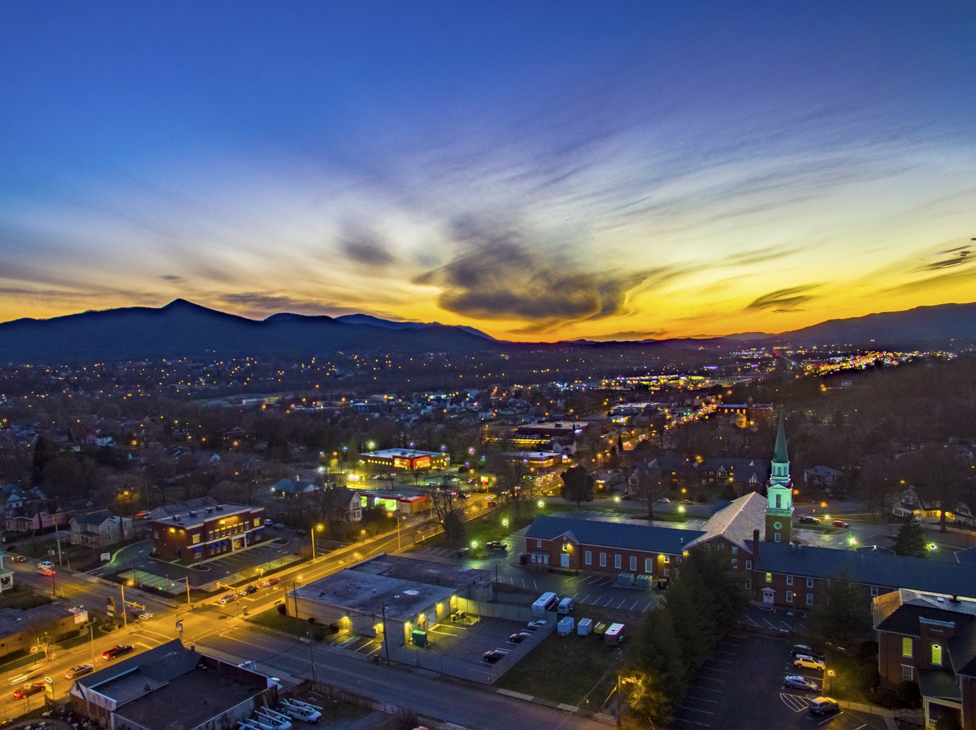


Slide 2
Agenda:
Introduction Presentation: 15-20 minutes
Open Dialogue: 10 minutes
Table Exercise: Work on Vision Statement: 30 minutes
Presentation: “What is a Corridor Study”: 10- 15 minutes
Open Dialogue: 5 minutes
Live Polling: 30 minutes

Slide 3
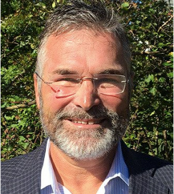
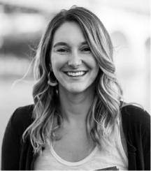
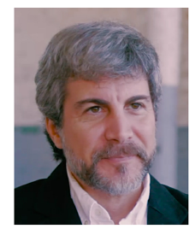

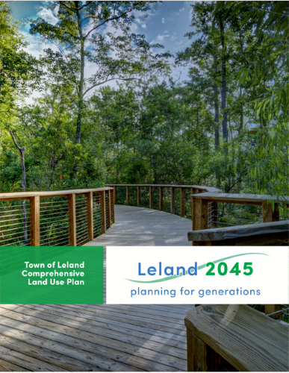
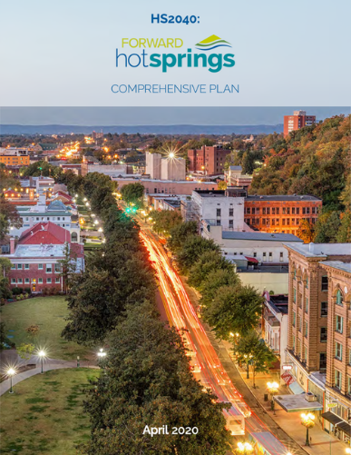
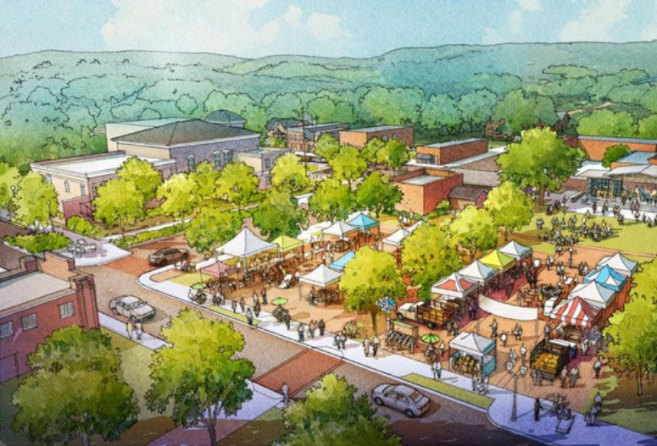
A collaborative group with decades of comprehensive planning experience
Best in class partners
Focused on comprehensive plans that add value and create ROI
Committed to community and stakeholder engagement
Innovators in comprehensive planning
Planner with design and implementation experience
Experience and a passion for working with smaller towns and cities
Comprehensive Plan Introduction | City of Salem, VA

Slide 4
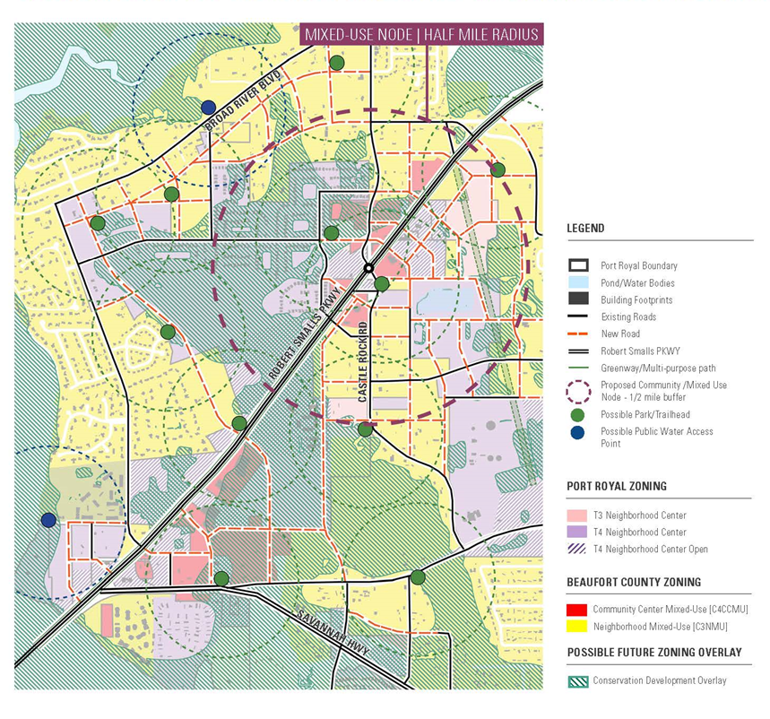

Our Experiences:
Plans for small towns
Mountain towns
Downtown plans
Corridor master plans
Mixed use neighborhoods
TOD (transit and trail oriented)
Parks and open space planning
Green infrastructure
Streetscapes and public space design
Comprehensive Plan Introduction | City of Salem, VA

Slide 5
A COMPREHENSIVE PLAN is a long-range tool to establish and guide city-wide policy decisions over several years:
A unified vision and set of aspirations
The impetus for actions, legislation, planning, financing
A resource to help guide decision making
Integrates existing planning work
Integrates best and current practices
Highlights strengths, challenges and opportunities
Outlines specific goals, strategies and actions
Establishes priorities to devote its energy and resources
Inspires new plans and ordinances
Is created by citizen and stakeholder input
Comprehensive Plan Introduction | City of Salem, VA

Slide 6
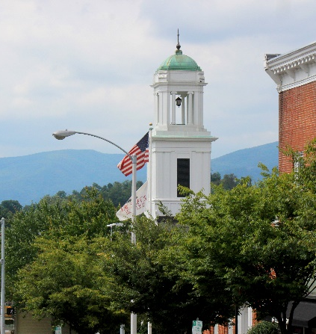
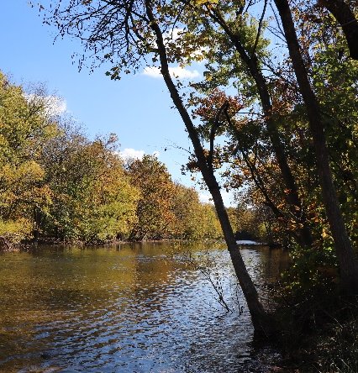
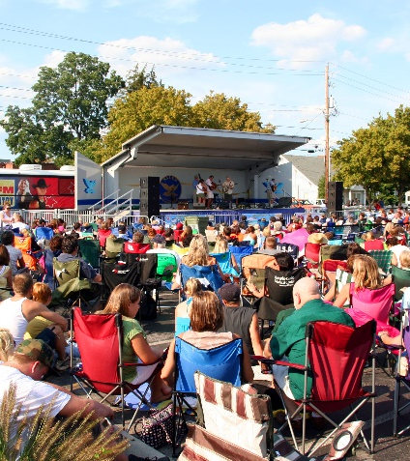
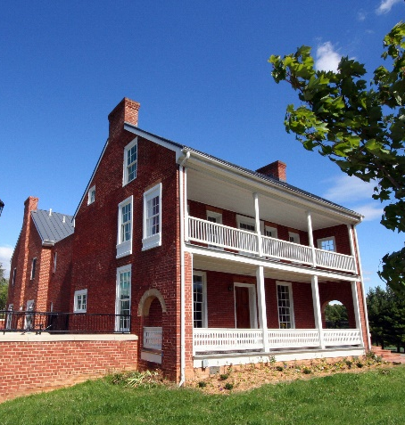
A COMPLETE COMMUNITY Functions in 4 “Realms”
A successful Comprehensive Plan leverages them forward
ECONOMIC
ENVIRONMENTAL
SOCIETAL
CULTURAL

Slide 7
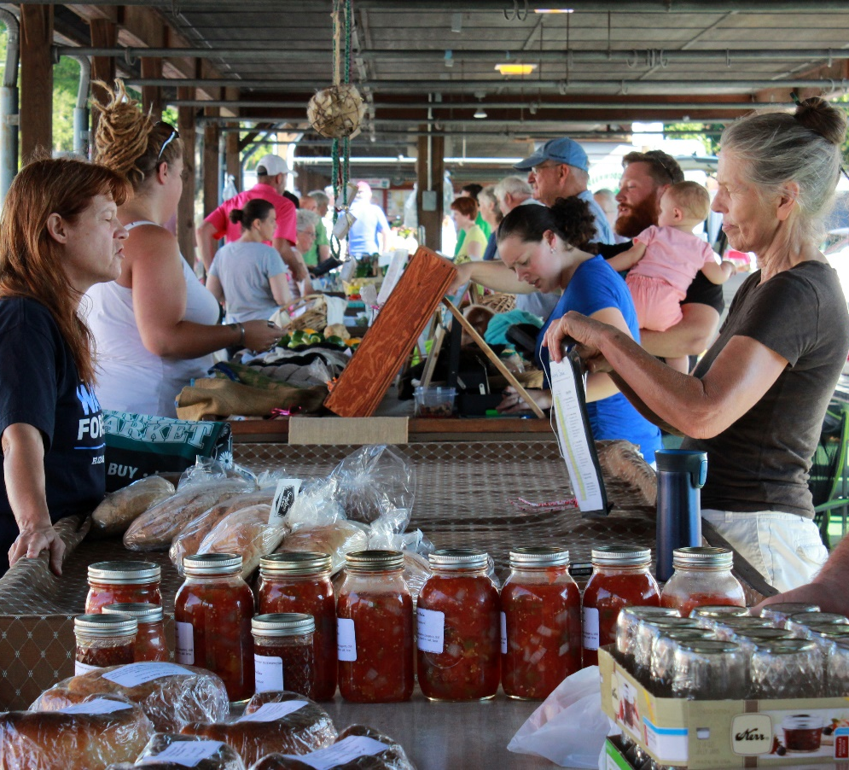
And considers ELEMENTS such as:
Population changes
Economic development
Natural resources
Cultural resources
Community facilities
Housing
Land use
Transportation
Priority investment
Comprehensive Plan Introduction | City of Salem, VA

Slide 8
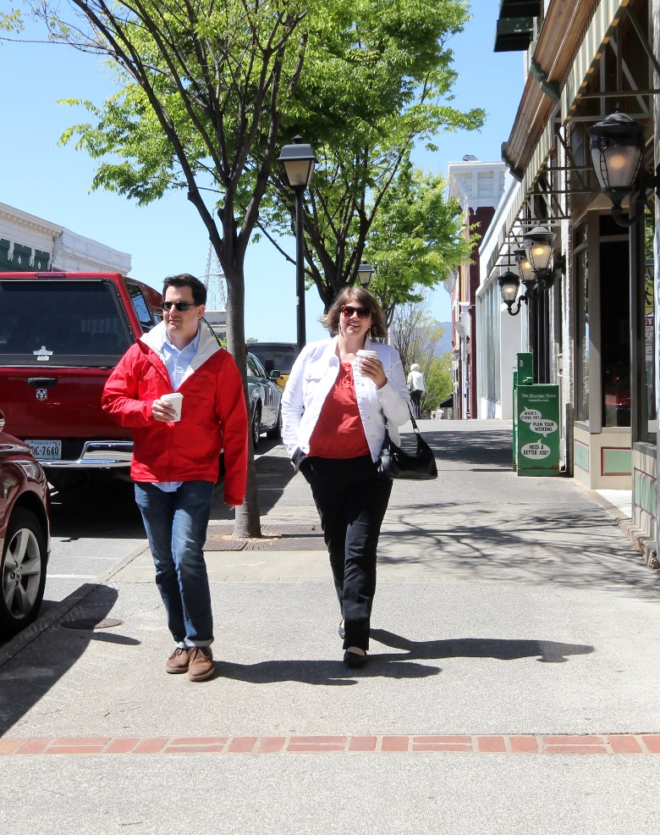
A Comprehensive Plan, however, is NOT
• A Zoning Code
• A Transportation Study
• A Policy on Affordable Housing
• A Market Study
• An Economic Development Plan
• A Branding Plan
• A Greenways Plan
It rides above these things and provides the vision and impetus for them and other plans and policies

Slide 9
Comprehensive Plan =
What Kind of Cake
Zoning and Land Use
Regulations = The Recipe
Comprehensive Plan Introduction | City of Salem, VA

Slide 10
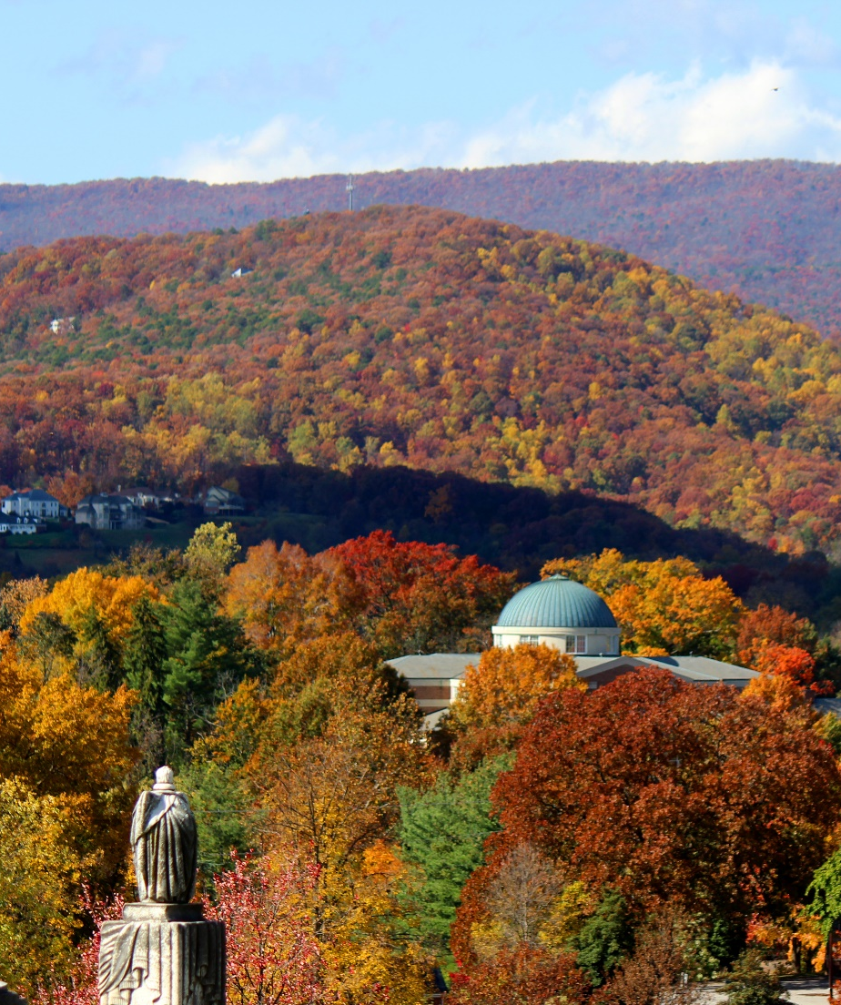
SUCCESS STORIES!
Streetscape implementation
Roanoke College
Roanoke River Greenway
Library, farmers market, brewery, coffee, and pizza - ingredients of success
Great neighborhoods on well connected streets
A beautiful mountain setting
Nice buildings, churches, and parks
Sports and recreation tourism
Hard work and investment
Comprehensive Plan Introduction | City of Salem, VA

Slide 11
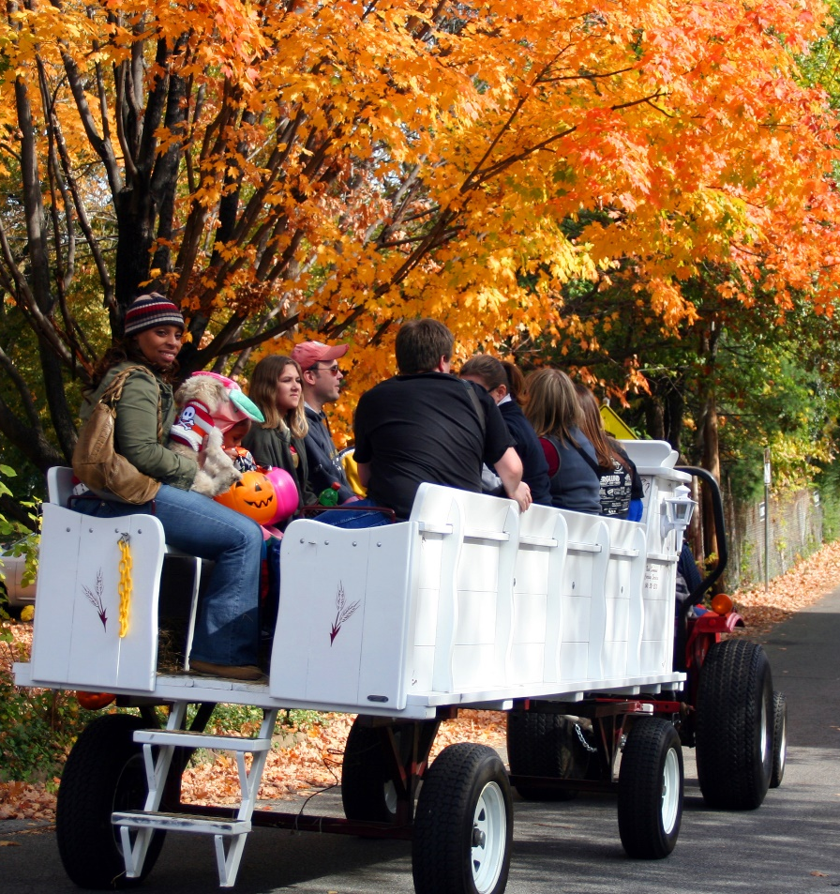
Keys to a great outcome:
Meaningful community and stakeholder participation
Stakeholder participation
Bringing elected officials along with the process
Plans that reflect analysis and community participation
Transparency and collaboration
Champions for the effort
Focusing in on those things that can make a tangible difference
Comprehensive Plan Introduction | City of Salem, VA

Slide 12
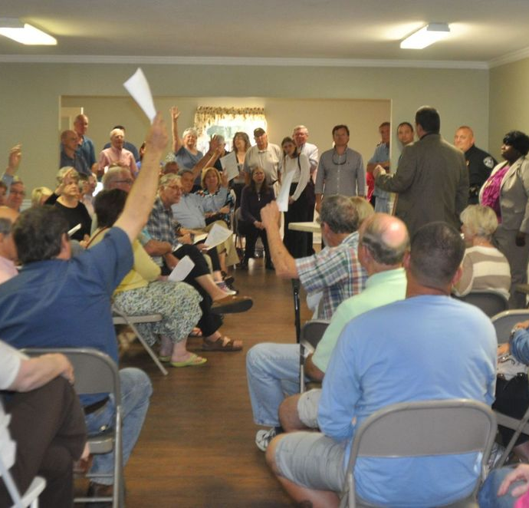
Existing planning efforts will support our work:
2012 Comprehensive Plan
Roanoke Valley Greenways Plan
The Downtown Plan
Downtown Plan Needs Assessment
RVAMPO Bikeway Plan
Roanoke Valley Transit Vision Plan
Regional Transportation Plan
Regional Housing Market Study
We can focus on gaps and be strategic and action oriented.
Comprehensive Plan Introduction | City of Salem, VA

Slide 13
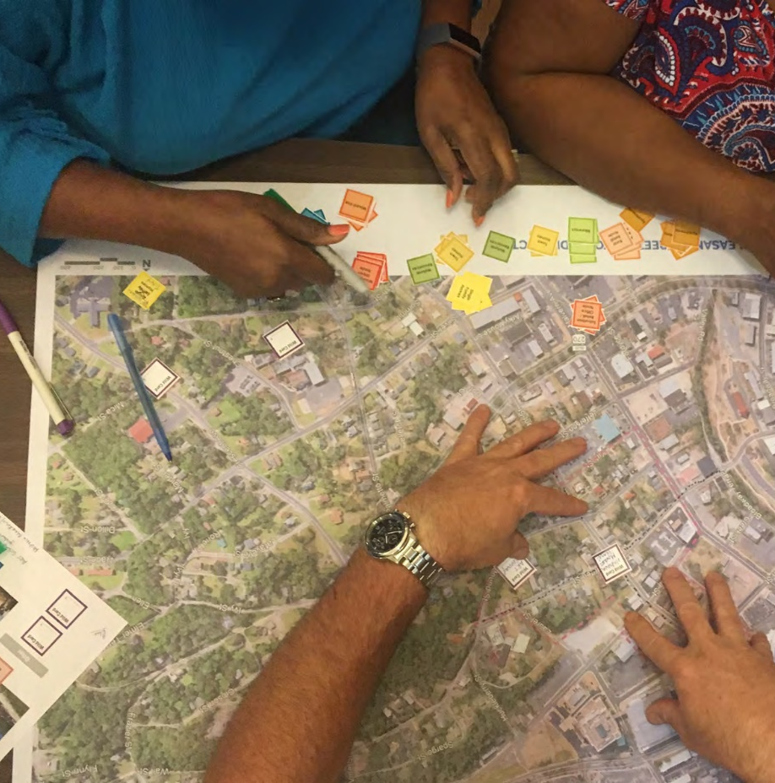
Process leads to predictable outcomes:
Foundation based on previous and ongoing work
Articulate what the words mean with plans and diagrams
Analytical logic + community input + application of experience
Simple, compelling, easy to read document
Action plan that creates accountability
Comprehensive Plan Introduction | City of Salem, VA

Slide 14
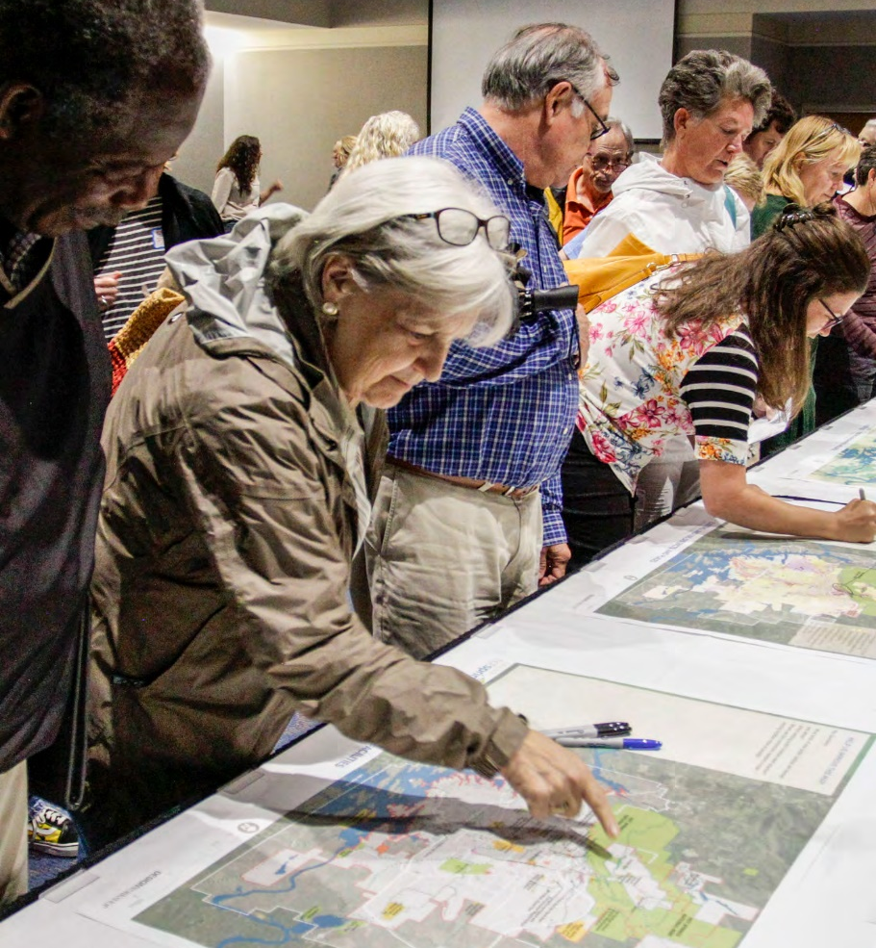
Community Process:
Mix of methods
Polling
Community workshops
Face to face meetings
Presence at community events
Ambassadors
Direct mail
Web site / virtual meetings
Chip Game
Business, social, cultural, educational, & neighborhood group meetings
Comprehensive Plan Introduction | City of Salem, VA

Slide 15
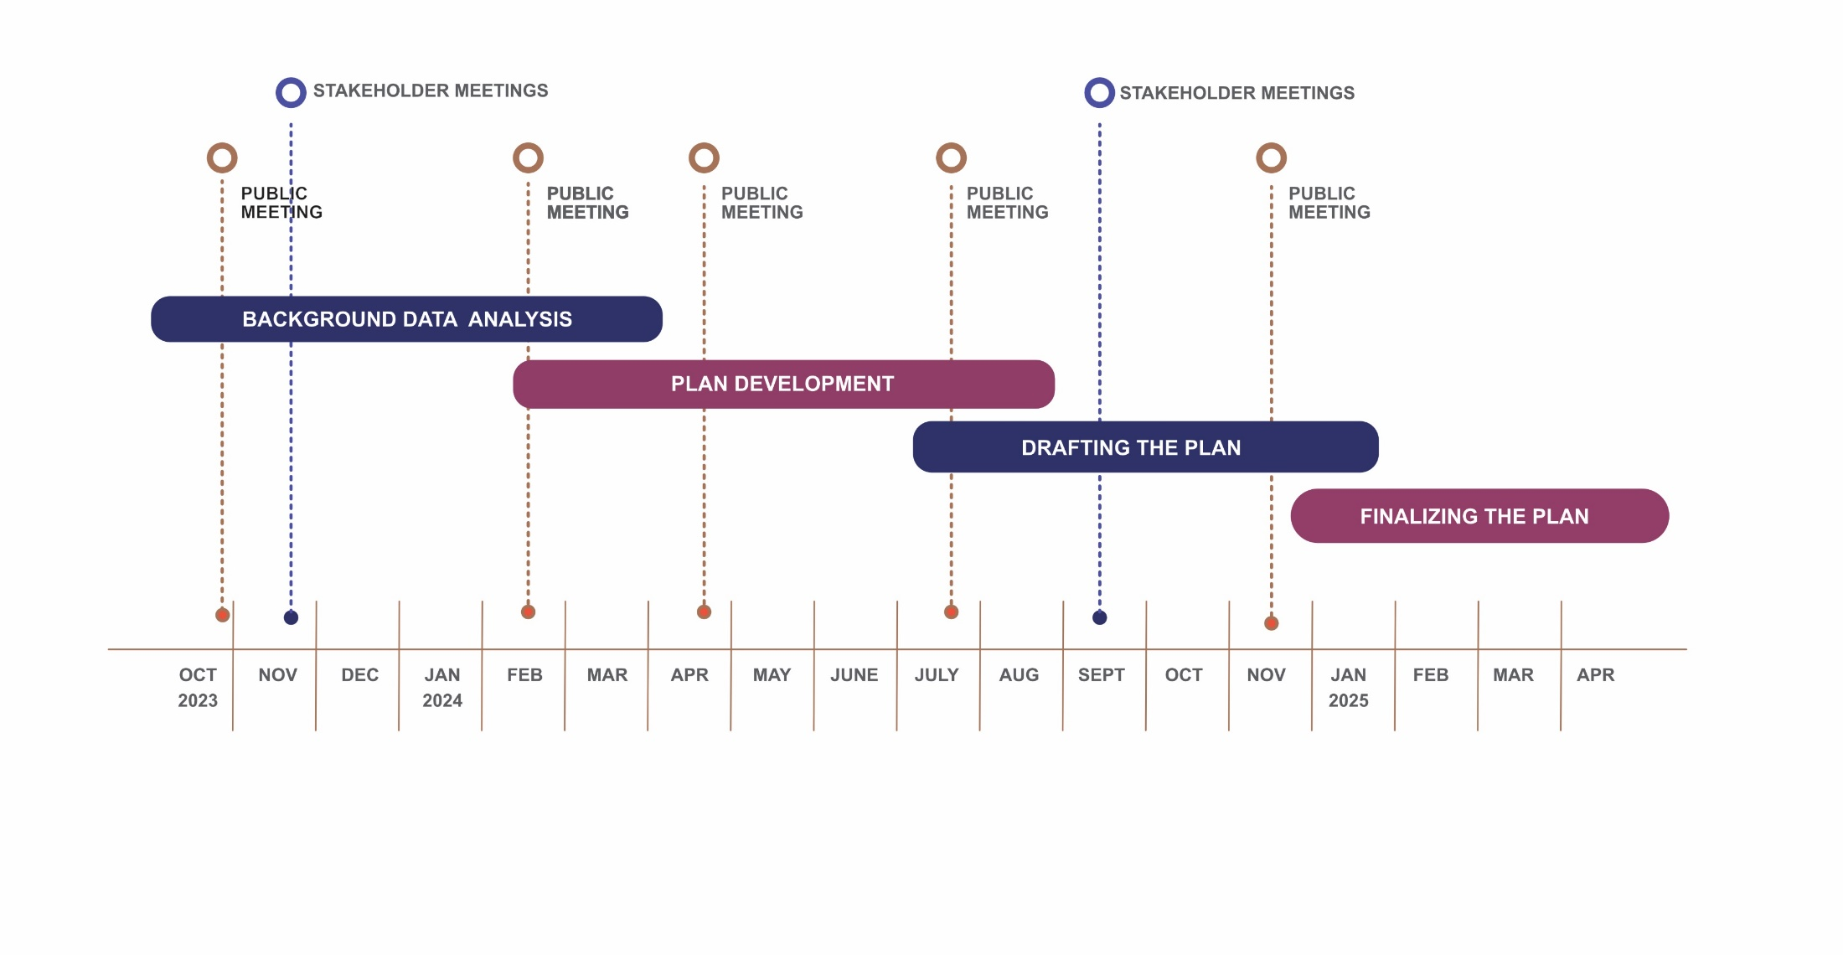
A process that will be inclusive and transparent
PLACE HOLDER
Comprehensive Plan Introduction | City of Salem, VA

Slide 16
We need your enthusiastic participation!
Follow our progress from our website:
www.salemva.gov/compplan
Comprehensive Plan Introduction | City of Salem, VA

Slide 17
Help us refine this draft Vision Statement:
Salem is a beautiful and proud mountain city. Our people are our greatest assets, and our “small-town” feel defines our character. Our commitment to nature and the outdoors, historic neighborhoods, community services, sports, and best in class schools foster a pride of place and a unique quality of life that is shared by all our citizens. As we encounter change, we will together respond in the “Salem Way” - wisely learning from our history and embracing the future with a fresh mindset.
Comprehensive Plan Introduction | City of Salem, VA

