Slide 1
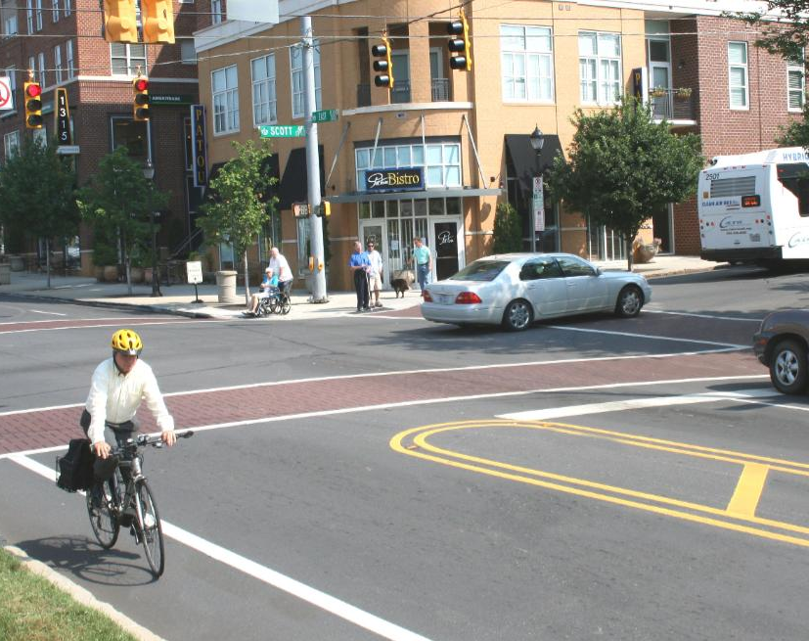
WHAT IS A CORRIDOR STUDY?

Slide 2
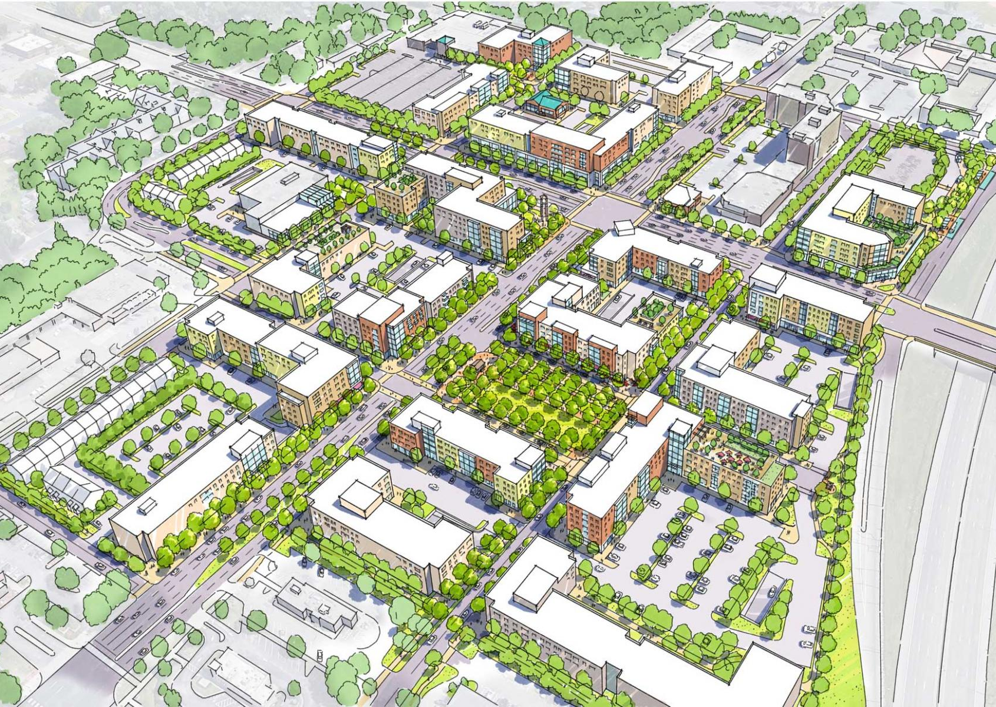

WHAT IS A CORRIDOR STUDY?
A vision for a roadway and its surroundings
to increase multi-modal options
to refine land use mix
toward a more “complete” street
Create walkability
Foster urban design strategies
An Action plan to realize the vision
A Strategy to create partnerships
VADOT
Property Owners
Utility Providers
Developers
The Municipality
The Community

Slide 3
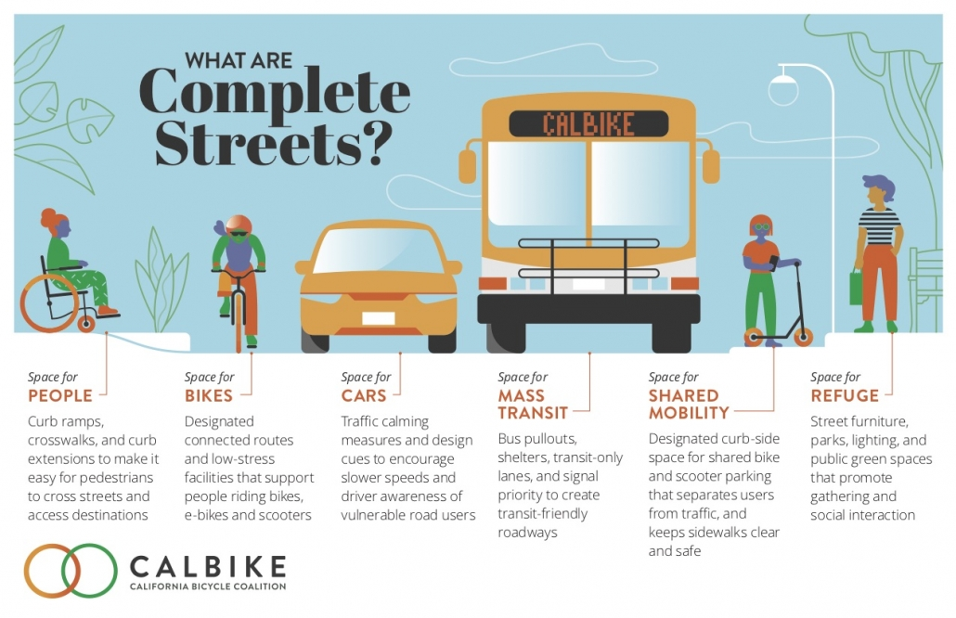
A vision for a roadway and its surroundings
to increase multi-modal options
to refine land use mix
toward a more “complete” street
Create walkability
Foster urban design strategies
An Action plan to realize the vision
A strategy to create partnerships
VADOT
Property Owners
Utility Providers
Developers
etc

Slide 4
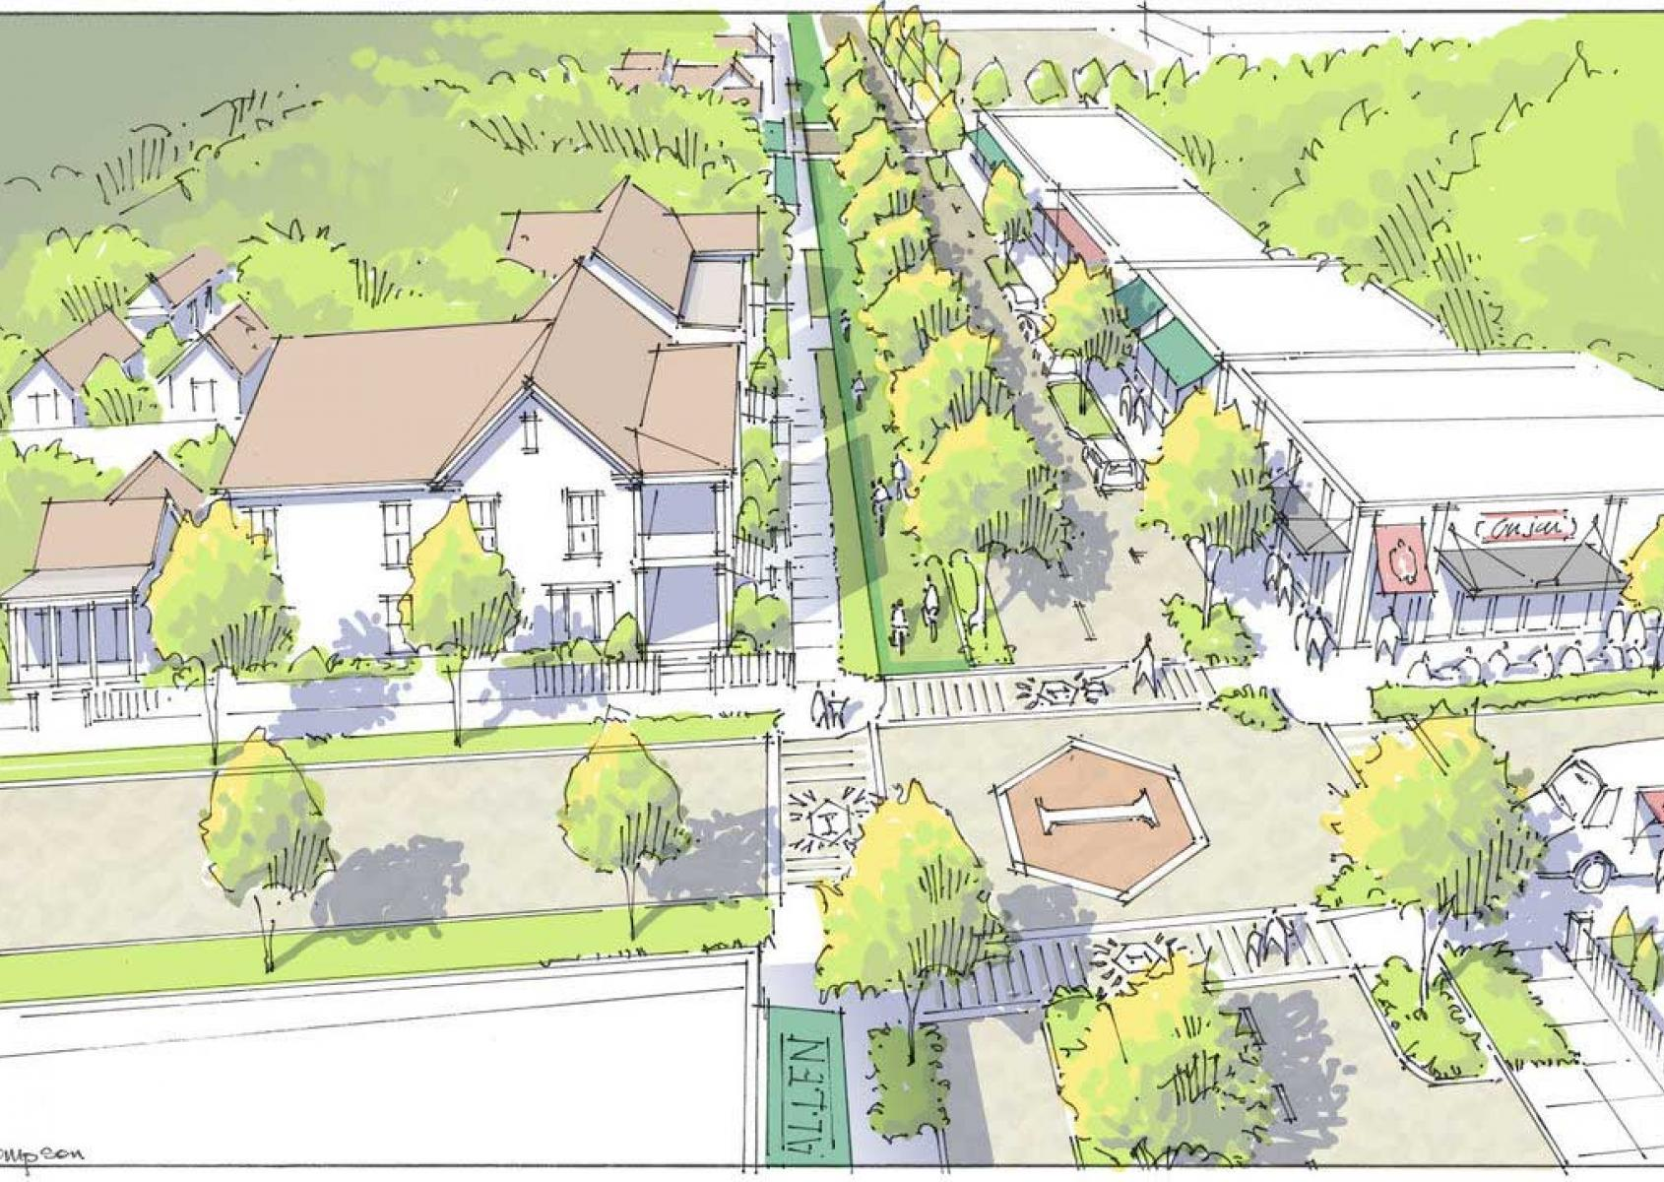
BENEFITS
Meet the vision and goals of the community
Reposition commercial corridors for economic success
Provide a more relevant mix of uses
Create a place and not just a strip
Provide multimodal transportation elements and options
Promote a more safe and pedestrian friendly roadway
Provide direction for how redevelopment should/could fit in
Increase property values
Increase tax revenues

Slide 5
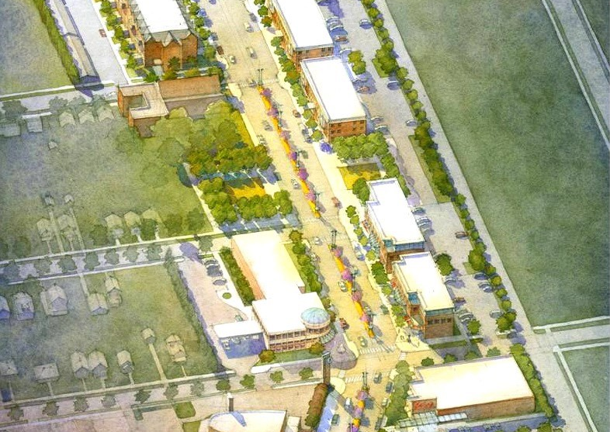
ELEMENTS OF A CORRIDOR STUDY?
Access Management
Road Diets
Traffic Calming
Back Street Connectivity
Streetscape
Building / Parking relationships
Sidewalks
Bike lanes
Transit stops
Crosswalks
Future Land Use
Urban Design Principles

Slide 6
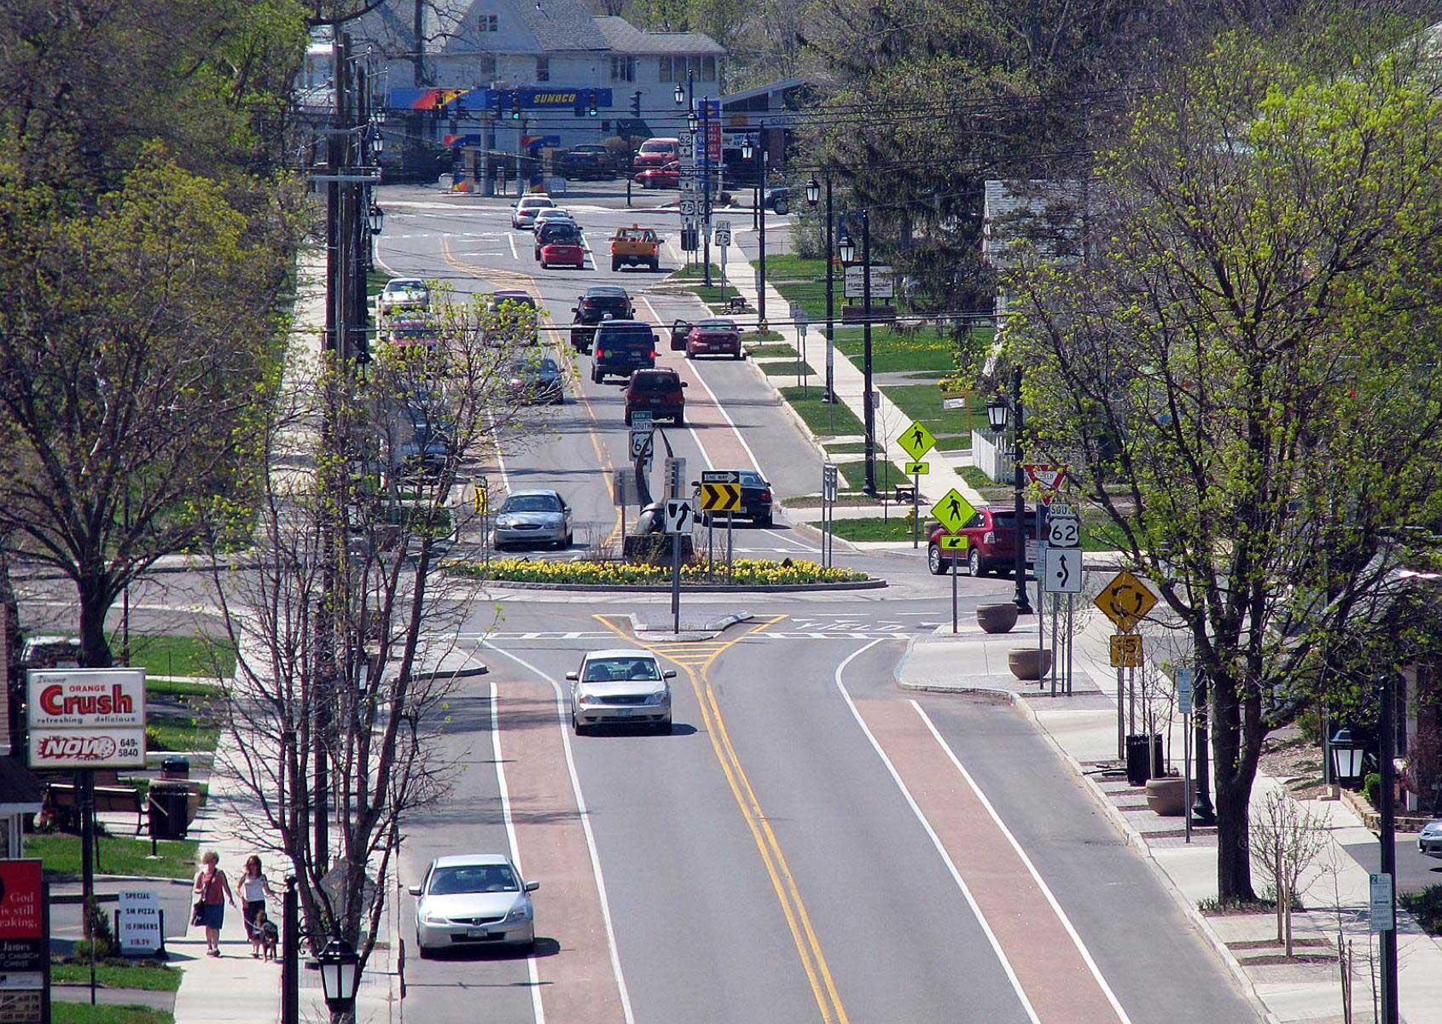
PROCESS
Community Input
Determining available space
Working with DOT
Deciding on Priorities
Locating Funding
Working with Business and Property Owners
Understanding existing and future market opportunities
Creating a block-by-block analysis of existing conditions
Creating a masterplan

Slide 7
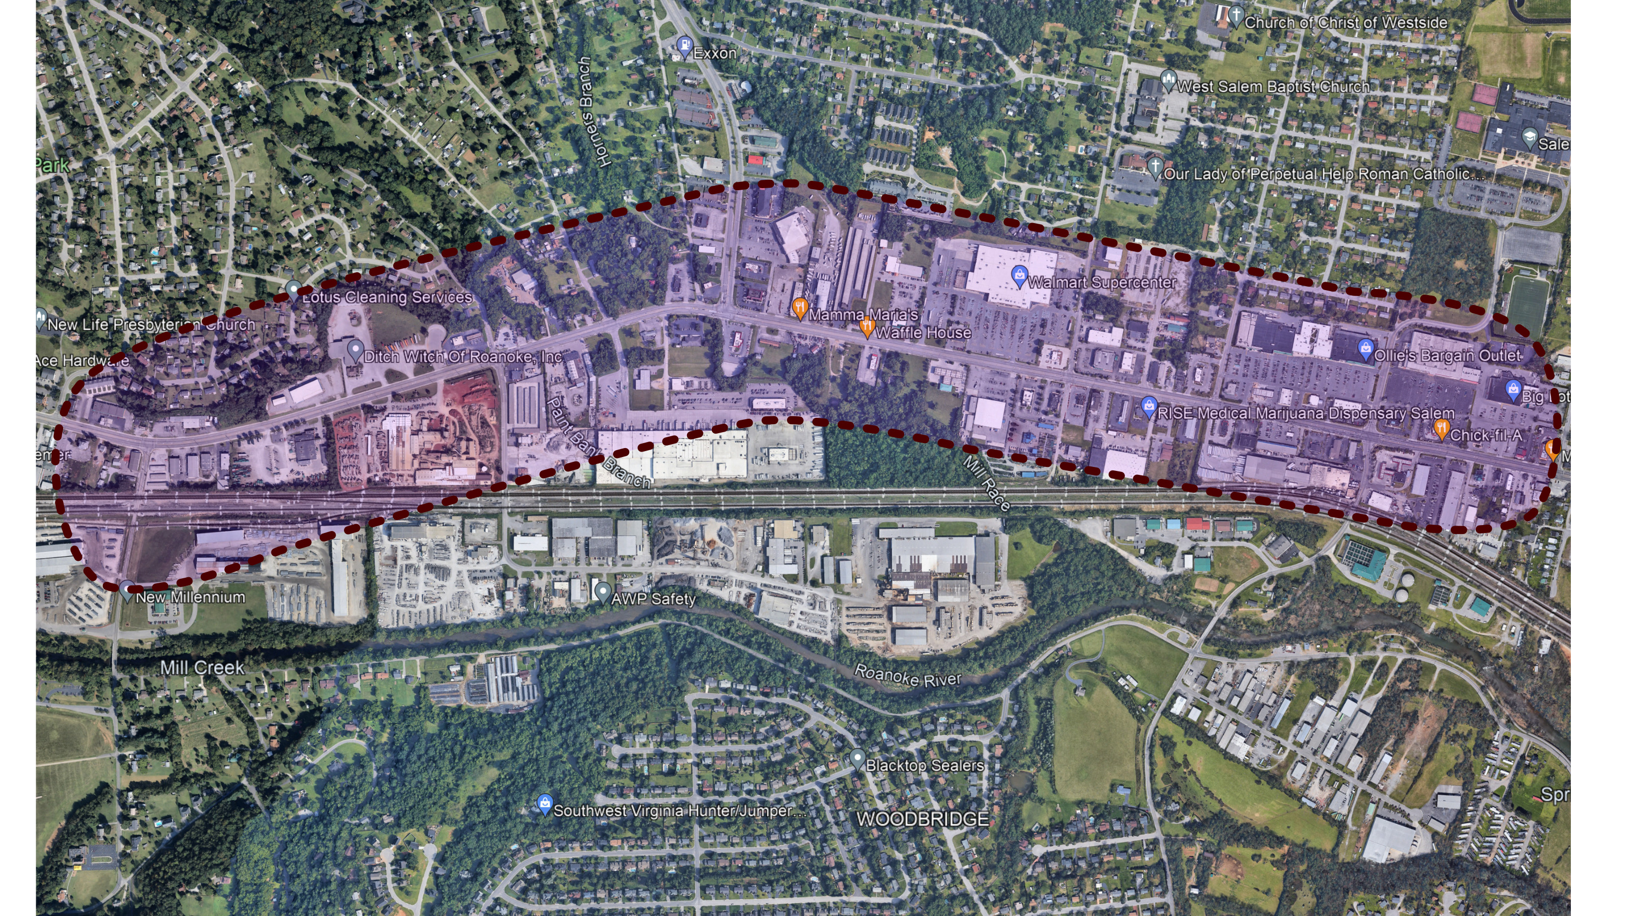
WEST MAIN

Slide 8

EAST MAIN

Slide 9
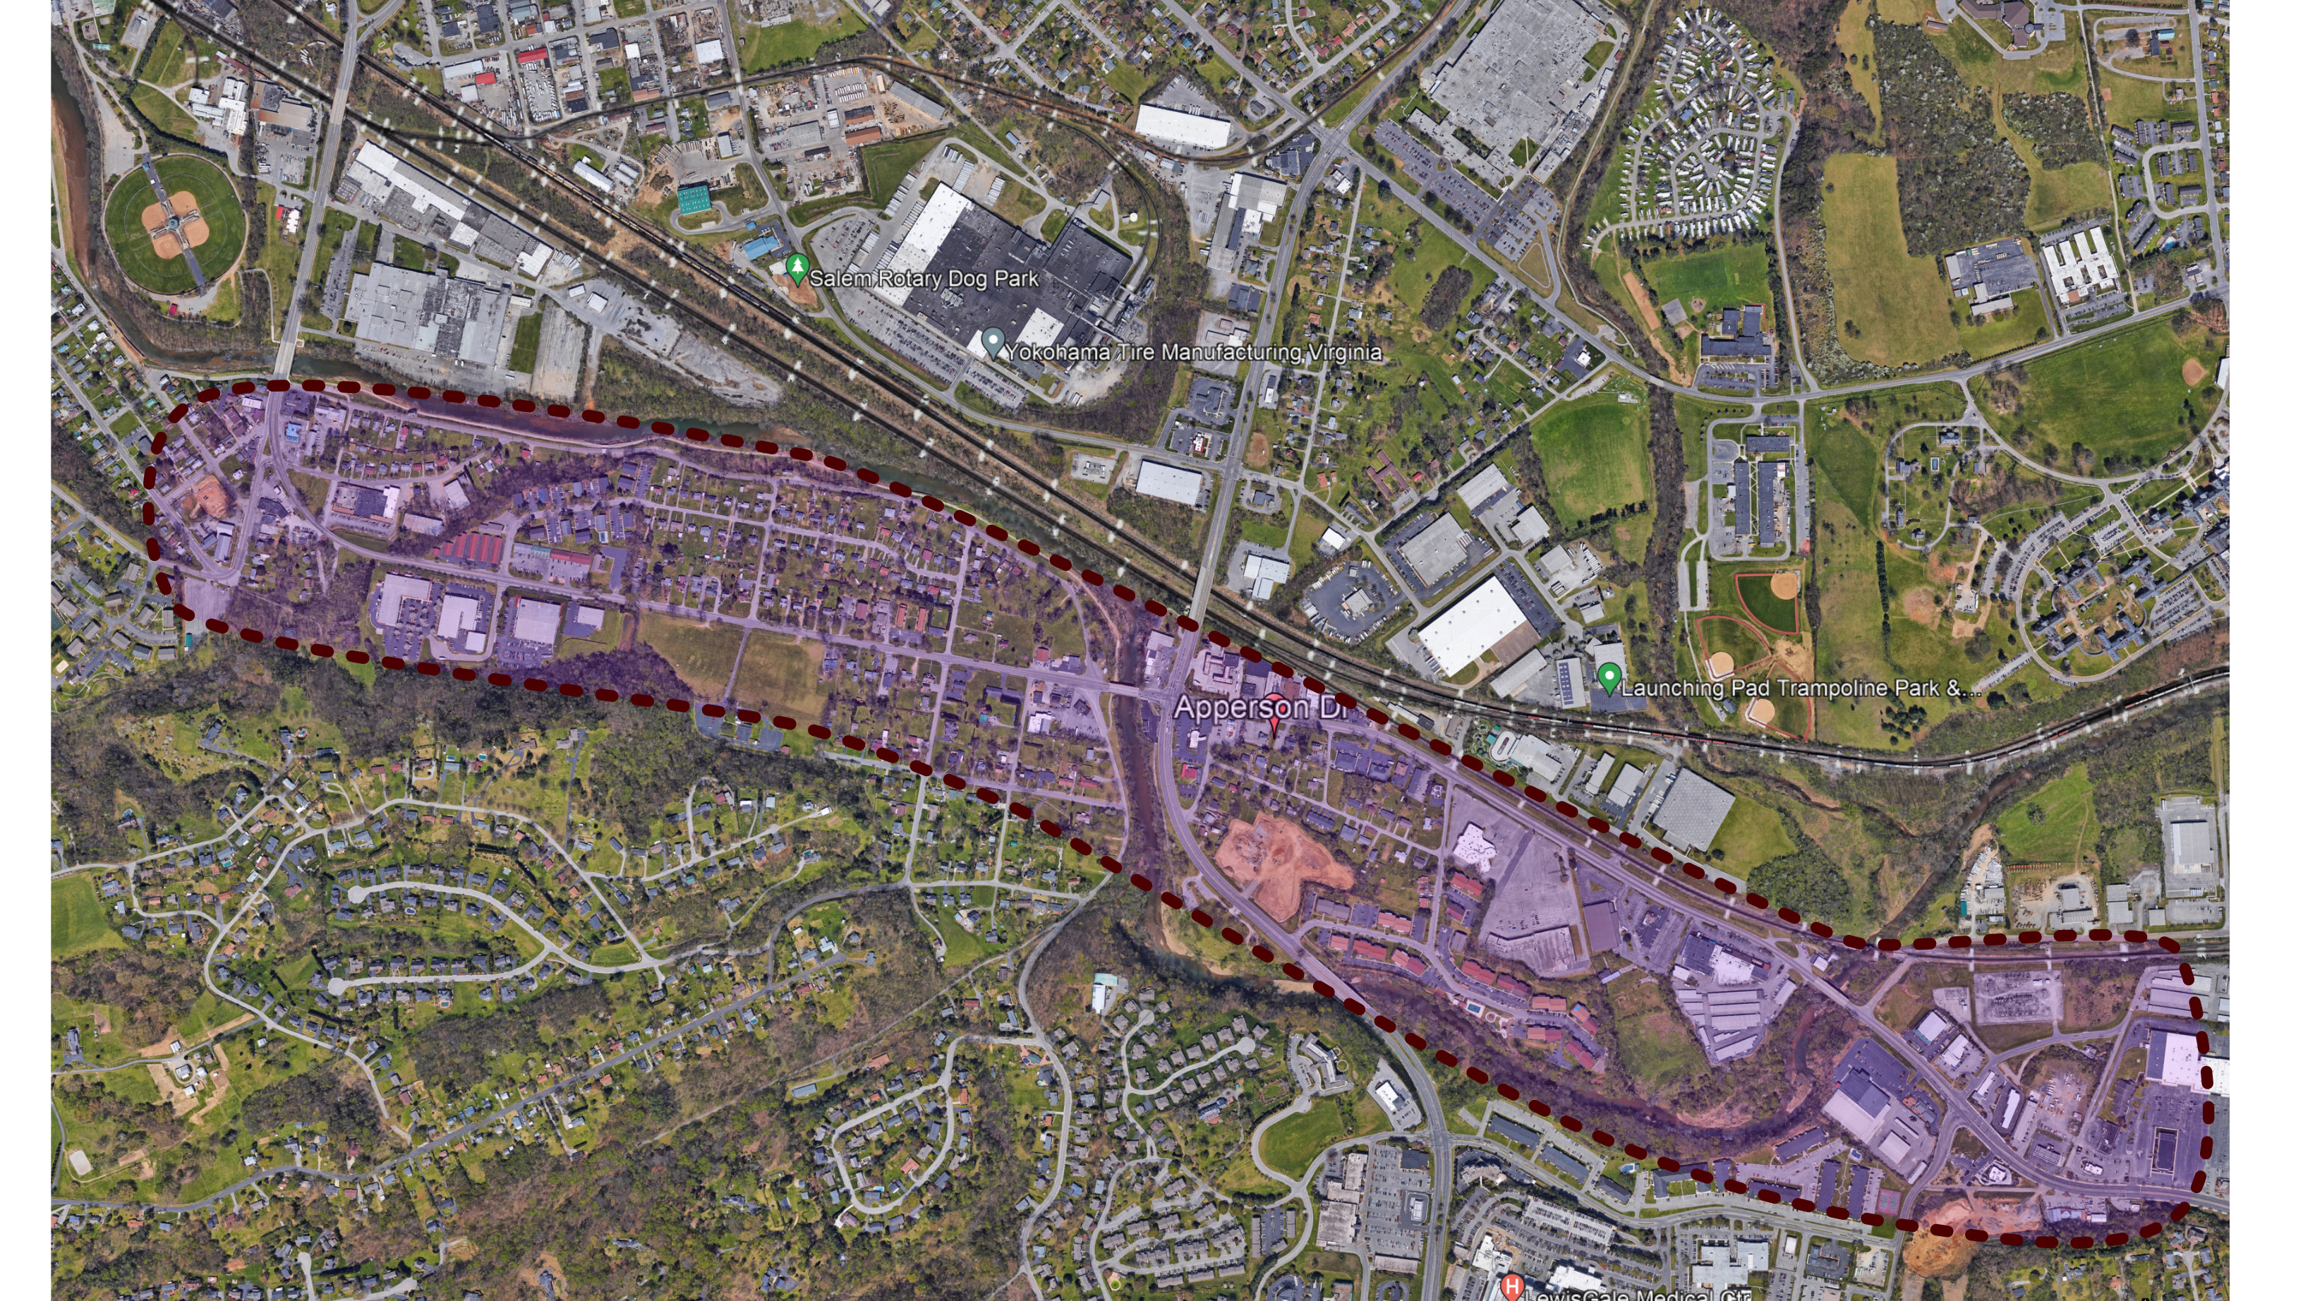
APPERSON

